Slide 1
Jumpstart to PHP Part 1
PHP Fundamentals

Slide 2
WAMP Overview
WampServer is a Windows web development environment. It allows you to create web applications with Apache, PHP and the MySQL database. It also comes with PHPMyAdmin to easily manage your databases.
With a left click on WampServer’s icon, you will be able to:
- manage your Apache and MySQL services
- switch online/offline (give access to everyone or only localhost)
- install and switch Apache, MySQL and PHP releases
- manage your servers settings
- access your logs
- access your settings files
- create alias
You will not see this dialog/panel (see left) if you are assessing from the school computer. The only to display it is from the browser: localhost:7070
Notes:
Once WampServer is installed, you have the possibility to add as many Apache, MySQL and PHP releases as you want.

Slide 3
WAMP Overview
APACHE – httpd.conf consists of the configuration file for your apache server. Use this file to manage your server/port number/etc
PHPMyAdMIN - phpMyAdmin is a free software tool written in PHP, intended to handle the administration of MySQL over the World Wide Web. phpMyAdmin supports a wide range of operations with MySQL. The most frequently used operations are supported by the user interface (managing databases, tables, fields, relations, indexes, users, permissions, etc), while you still have the ability to directly execute any SQL statement.
MySQL - allows access to MySQL console, where you can issue commands to create, update, delete, manipulate data in your databases in your server using SQL commands.
Notes:
Once WampServer is installed, you have the possibility to add as many Apache, MySQL and PHP releases as you want.

Slide 4

WAMP Installation
Get your WAMP from http://www.wampserver.com
  Choose 32 or 64 bit OS.
WARNING : You must install Visual C++ 2010 SP1 Redistributable Package x86 or x64
VC10 SP1 vcredist_x86.exe 32 bits : http://www.microsoft.com/download/en/details.aspx?id=8328
VC10 SP1 vcredist_x64.exe 64 bits : http://www.microsoft.com/download/en/details.aspx?id=13523
WARNING : Do not try to install WampServer 2 over WAMP5.

Slide 5
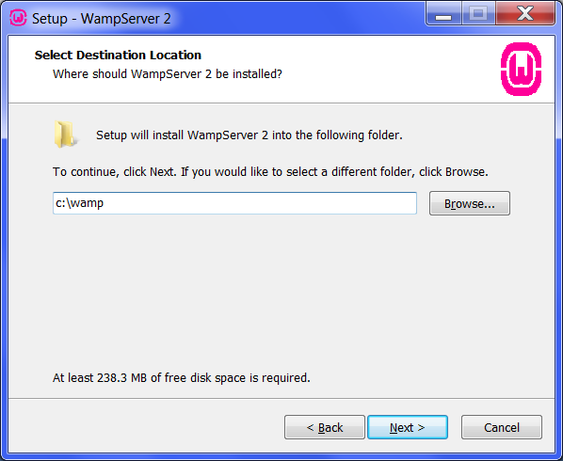
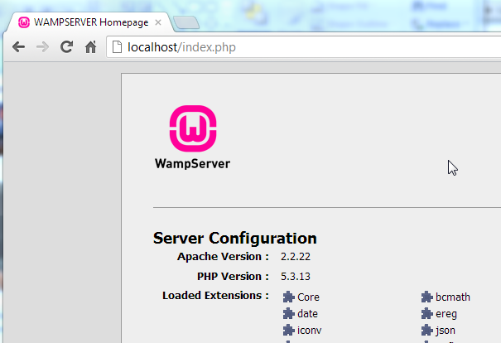
Jumpstart to PHP, MySQL
The root folder will be created during installation: Eg. c:/wamp/www.
This is where you will place all the .php files and access them from the browser via the localhost.
Notes:
This is where you will place all the .php files and access them from the browser via the localhost.

Slide 6
Jumpstart to PHP, MySQL
After installation, start all services. Or if you made changes to httpd.conf (configuration file) or any other config files, you will have to restart the services.
Notes:
This is where you will place all the .php files and access them from the browser

Slide 7
PHP Syntax
<?php ….. ?>
Any code within the <?php ….. ?> tags are interpreted as php codes
A php document can include html tag, which will be parsed like any other html tags in the browser
Notes:
PHP codes are embedded in a document using the <

Slide 8
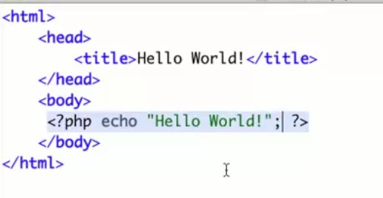
Jumpstart to PHP, MySQL
For example the following Helloworld.php is created (using notepad++) and saved in the root folder.
We may then access it from the browser
Notes:
Note that anything within the <?php ….. ?> tags will be intepreted by the server as php codes

Slide 9
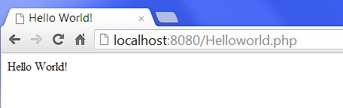
Jumpstart to PHP, MySQL
For example the following Helloworld.php is created (using notepad++) and saved in the root folder.
Notes:
Note some ports may conflict. In my case I edited httpd.conf to listen to 8080 instead of 80, and ServerName localhost:8080 instead of 80. See practical for me details.

Slide 10
PHP Variables
Start with a $
Followed by letter or underscore
Can contain letters. Numbers, underscores or dashes
No spaces
Case sensitive

Slide 11
PHP Variables
Examples
  $item
  $Item
  $myVariable
  $this_variable
  X $this-variable ( avoid Hyphens)
  $product3
Notes:
Try avoid – hyphens in your variables.

Slide 12
PHP Strings
. Operator - concatenate
<?php
$txt1="Hello World!";
$txt2="What a nice day!";
echo $txt1 . " " . $txt2;
?>
Output:
Hello World! What a nice day!

Slide 13
PHP Strings
strlen() function
<?php
echo strlen("Hello world!");
?>
Output:
12
Notes:
The length of a string is often used in loops or other functions, when it is important to know when the string ends. (i.e. in a loop, we would want to stop the loop after the last character in the string).

Slide 14
PHP Strings
strpos() function
<?php
echo strpos("Hello world!","world");
?>
Output:
6
Notes:
The strpos() function is used to search for a character/text within a string.
If a match is found, this function will return the character position of the first match. If no match is found, it will return FALSE.
Let's see if we can find the string "world" in our string:

Slide 15
PHP Strings –example 1
str_replace(find,replace,string,count)
<?php
echo str_replace("world","Peter","Hello world!");
?>
Output:
Hello Peter!

Slide 16
PHP Strings –example 2
str_replace(find,replace,string,count)
<?php
$arr = array("blue","red","green","yellow");
print_r(str_replace("red","pink",$arr,$i));
echo "Replacements: $i";
?>
Output:
Array
(
[0] => blue
[1] => pink
[2] => green
[3] => yellow
)
Replacements: 1

Slide 17
PHP Strings Substr –example 3
substr(string,start,length)
Parameter | Description
string | Required. Specifies the string to return a part of
start | Required. Specifies where to start in the stringA positive number - Start at a specified position in the string A negative number - Start at a specified position from the end of the string 0 - Start at the first character in string
length | Optional. Specifies the length of the returned string. Default is to the end of the string.A positive number - The length to be returned from the start parameter Negative number - The length to be returned from the end of the string

Slide 18
PHP Strings Substr –example 3
substr(string,start,length)
Example | Output
echo substr("Hello world!",6); | world!
echo substr("Hello world!",6,5); | world
echo substr("Hello world!",6,3); | wor

Slide 19
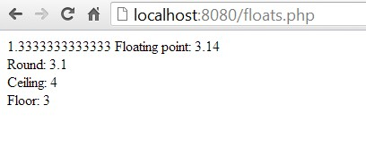
PHP Floats
Round(), ceil(), floor()
Output:
Floating point: <?php echo $myFloat = 3.14; ?><br />
Round: <?php echo round($myFloat, 1); ?><br />
Ceiling: <?php echo ceil($myFloat); ?><br />
Floor: <?php echo floor($myFloat); ?><br />

Slide 20
PHP Math Functions
Absolute Value : abs(0 – 300); gives 300
Exponential: pow(2,8); gives 2⁸
Square Root: sqrt(100); gives 10
Modulo: fmod(20,7) gives remainder of 20/7
Random(any): rand(); gives random number
Random(min,max): gives u random number betw the min and max numbers.

Slide 21
PHP Arrays – example 1
$array1 = array(4,8,15,16,23,42);
echo $array1[0];
Output: 4
Arrays always start from 0

Slide 22
PHP Arrays – example 2
$array2 = array(6,"fox", "dog", array("x", "y", z"));
echo $array2[3][2];
Output: z
Notes:
// arrays can contain a mix of strings, numbers, even other arrays . You can reference an array value that is inside another array

Slide 23
PHP Arrays – example 4
$array2 = array(6,"fox", "dog", array("x", "y", z"));
$array2[1] = "cat";
echo $array2[1];
$array2 = array(6,“cat", "dog", array("x", "y", z"));
Output: cat
Notes:
This is how you change the value within an array.

Slide 24
PHP Arrays – example 5 Associative Arrays
$array3 = array("first_name" => "Kevin", "last_name" => “Lim );
echo $array3["first_name"] . " " . $array3["last_name"] . "<br />";
Output: Kevin Lim
Notes:
You can also assign labels to each pocket (called "keys"),

Slide 25
PHP Arrays – example 6 Array Functions
$array1 = array(4,8,15,16,23,42);
count($array1);
max($array1);
min($array1);
sort($array1); print_r($array1);
rsort($array1); print_r($array1);
Reference:http://www.w3schools.com/php/php_arrays.asp
Notes:
RSORT= reverse sort

Slide 26
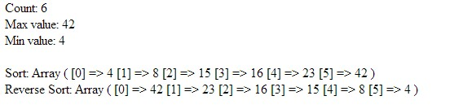
PHP Arrays – example 6 Array Functions
Notes:
You can also assign labels to each pocket (called "keys"),

Slide 27
PHP Typecasting
PHP re-casts variables on-the-fly. So, the following code is valid:
explicitly cast a variable,
Casting on the fly
$var = "10";
$value = 10 + $var;
$value = (string)$value;
var_dump($value); // string(2) "20"
$var = "10";
$value = 10 + $var;
var_dump($value); // int(20)
Casting using settype
Casting using (type)
settype($foo, "array");
settype($foo, "bool");
settype($foo, "boolean");
settype($foo, "float");
settype($foo, "int");
settype($foo, "integer");
settype($foo, "null");
settype($foo, "object");
settype($foo, "string");
$foo = (array)$foo;
$foo = (binary)$foo;
$foo = (bool)$foo;
$foo = (boolean)$foo;
$foo = (double)$foo;
$foo = (float)$foo;
$foo = (int)$foo;
$foo = (integer)$foo;
$foo = (object)$foo;
$foo = (string)$foo;
Notes:
Casting simply means converting data from one type to another.

Slide 28
PHP Typecasting
Setting the data type for a variable:
settype($var2, "string");
Checking datatype for a variable:
is_bool($var1)
is_float($var1);
is_int($var1);
is_null($var1);
is_numeric($var1);
is_string($var1);
Notes:
Use settype() to set the datatype
Use the is_XXX() functions for checking datatype fpr variable

Slide 29
PHP Controls
IF Else
if (condition)
{
code to be executed if condition is true;
}
else
{
code to be executed if condition is false;
}

Slide 30
PHP IF ELSE controls
IF Else
<?php $d=date("D");
if ($d=="Fri")
{
echo "Have a nice weekend!";
}
else
{
echo "Have a nice day!";
}
?>
Notes:
This checks if the date is Fri (or Friday) If it is, it will return Have a nice weekend otherwise - echo "Have a nice day!";

Slide 31
PHP IF ELSEIF controls
if (condition)
{
code to be executed if condition is true;
}
elseif (condition)
{
code to be executed if condition is true;
}
else
{
code to be executed if condition is false;
}

Slide 32
PHP WHILE CONTROLS
while (condition)
{
code to be executed;
}

Slide 33
PHP WHILE CONTROLS
<?php
$i=1;
while($i<=5)
{ echo "The number is " . $i . "<br />";
$i++;
}
?>
The number is 1
The number is 2
The number is 3
The number is 4
The number is 5

Slide 34
PHP FOR LOOPS
for (init; condition; increment)
{
code to be executed;
}

Slide 35
PHP FOR LOOPS
<?php
for ($i=1; $i<=5; $i++)
{
echo "The number is " . $i . "<br />";
}
?>
The number is 1
The number is 2
The number is 3
The number is 4
The number is 5

Slide 36
PHP FOR EACH
foreach ($array as $value)
{
code to be executed;
}

Slide 37
PHP FOR EACH
<?php
$x=array("one","two","three");
foreach ($x as $value)
{
echo $value . "<br />";
}
?>
one
two
three

Slide 38
PHP FORMS POST
The $_POST Variable
The predefined $_POST variable is used to collect values from a form sent with method="post".
Information sent from a form with the POST method is invisible to others and has no limits on the amount of information to send.
Note: However, there is an 8 Mb max size for the POST method, by default (can be changed by setting the post_max_size in the php.ini file).

Slide 39
PHP FORMS POST
Forms.php
Welcome.php
<form action="welcome.php" method="post">Name: <input type="text" name="fname" />Age: <input type="text" name="age" /><input type="submit" /></form>
Welcome
<?php echo $_POST["fname"]; ?>!<br />
You are <?php echo $_POST["age"]; ?> years old.

Slide 40
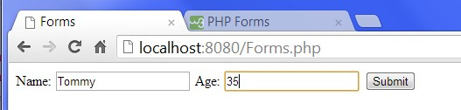
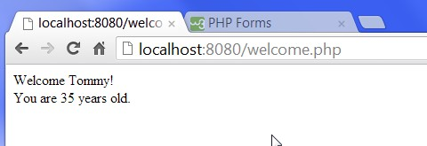
PHP FORMS POST
Forms.php
Welcome.php

Slide 41
PHP FORMS GET
The $_GET Variable
The predefined $_GET variable is used to collect values in a form with method="get“
Information sent from a form with the GET method is visible to everyone (it will be displayed in the browser's address bar) and has limits on the amount of information to send.

Slide 42
PHP FORMS GET
Forms_get.php
Welcome_get.php
<form action=" Welcome_get.php" method="get">
Name: <input type="text" name="fname" />
Age: <input type="text" name="age" />
<input type="submit" />
</form>
Welcome <?php echo $_GET["fname"]; ?>.<br />
You are <?php echo $_GET["age"]; ?> years old!

Slide 43
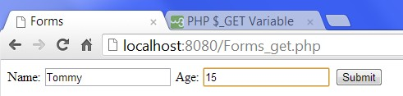
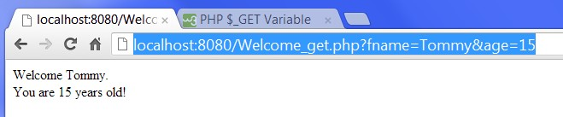
PHP FORMS POST
Forms_get.php
Welcome_get.php

Slide 44
PHP FUNCTIONS
function functionName()
{
code to be executed;
}

Slide 45
PHP FUNCTIONS
<?php
function writeName()
{
echo "Kai Jim";
}
echo "My name is ";
writeName();
?>
Output:
My name is Kai Jim
Notes:
The code will call writeName when the php file is loaded, and the output will be
“My name is Kai Jim

Slide 46
PHP FUNCTIONS (With Parameters)
<?php
function writeName($fname)
{ echo $fname . " Refsnes.<br />“;}
echo "My name is ";
writeName("Kai Jim");
echo "My sister's name is ";
writeName("Hege");
echo "My brother's name is ";
writeName("Stale"); ?>
Output
My name is Kai Jim Refsnes.
My sister's name is Hege Refsnes.
My brother's name is Stale Refsnes.
Notes:
To add more functionality to a function, we can add parameters. A parameter is just like a variable.
Parameters are specified after the function name, inside the parentheses. For two parameters,
Just add a comma between the first and second parameter.

Slide 47
PHP FUNCTIONS (With Return Value)
<?php
function add($x,$y)
{
$total=$x+$y;
return $total;
}
echo "1 + 16 = " . add(1,16);
?>
Output
1 + 16 = 17
Notes:
To add more functionality to a function, we can add parameters. A parameter is just like a variable.
Parameters are specified after the function name, inside the parentheses. For two parameters,
Just add a comma between the first and second parameter.

Slide 48
PHP Sessions
A PHP session
allows you to store user information on the server for later use (i.e. username, shopping items, etc).
session information is temporary and will be deleted after the user has left the website.
Sessions work by creating a unique id (UID) for each visitor and store variables based on this UID.
The UID is either stored in a cookie or is propagated in the URL.
Notes:
When you are working with an application, you open it, do some changes and then you close it. This is much like a Session. The computer knows who you are. It knows when you start the application and when you end. But on the internet there is one problem: the web server does not know who you are and what you do because the HTTP address doesn't maintain state.
A PHP session solves this problem by allowing you to store user information on the server for later use (i.e. username, shopping items, etc). However, session information is temporary and will be deleted after the user has left the website. If you need a permanent storage you may want to store the data in a database.
Sessions work by creating a unique id (UID) for each visitor and store variables based on this UID. The UID is either stored in a cookie or is propagated in the URL.

Slide 49
PHP Sessions - Start
<?php session_start(); ?>
<html>
<body>
</body>
</html>
Notes:
Before you can store user information in your PHP session, you must first start up the session.
Note: The session_start() function must appear BEFORE the <html> tag:

Slide 50
PHP Sessions – Page Views using Session Variables
<?php
session_start();
// store session data
$_SESSION['views']=1;
?>
<html>
<body>
<?php
//retrieve session data
echo "Pageviews=". $_SESSION['views'];
?>
</body>
</html>
Pageviews=1
Notes:
Storing a Session Variable
The correct way to store and retrieve session variables is to use the PHP $_SESSION variable:

Slide 51
PHP Sessions - Storing
<?php
session_start();
if(isset($_SESSION['views']))
$_SESSION['views']=$_SESSION['views']+1;
else
$_SESSION['views']=1;
echo “Pageviews=". $_SESSION['views'];
?>
Pageviews=1
Pageviews=2
Pageviews=3
Notes:
In this example we create a simple page-views counter. The isset() function checks if the "views" variable has already been set. If "views" has been set, we can increment our counter. If "views" doesn't exist, we create a "views" variable, and set it to 1:

Slide 52
PHP Sessions – Destroying Session
If you wish to delete some session data, you can use the unset() or the session_destroy() function.
The unset() function is used to free the specified session variable:
<?php
session_start();
if(isset($_SESSION['views']))
unset($_SESSION['views']);
?>
You can also completely destroy the session by calling the session_destroy() function:
<?php
session_destroy();
?>
Notes:
Note: session_destroy() will reset your session and you will lose all your stored session data.

Slide 53
PHP Cookies
How to Create a Cookie?
The setcookie() function is used to set a cookie.
Note: The setcookie() function must appear BEFORE the <html> tag.
setcookie(name, value, expire, path, domain);
Example 1:
In the example below, we will create a cookie named "user" and assign the value "Alex Porter" to it. We also specify that the cookie should expire after one hour:
<?php
setcookie("user", "Alex Porter", time()+3600);
?>
<html>
.....

Slide 54
PHP Cookies - Creation
Creating a Cookie
The setcookie() function is used to set a cookie.
Note: The setcookie() function must appear BEFORE the <html> tag.
setcookie(name, value, expire, path, domain);
Example 1:
In the example below, we will create a cookie named "user" and assign the value "Alex Porter" to it. We also specify that the cookie should expire after one hour:
<?php
setcookie("user", "Alex Porter", time()+3600);
?>
<html>
.....
Notes:
Note: The value of the cookie is automatically URLencoded when sending the cookie, and automatically decoded when received (to prevent URLencoding, use setrawcookie() instead).

Slide 55
PHP Cookies - Creation
setcookie(name, value, expire, path, domain);
Example 2:
You can also set the expiration time of the cookie in another way. It may be easier than using seconds.
<?php
$expire=time()+60*60*24*30;
setcookie("user", "Alex Porter", $expire);
?>
<html>
.....

Slide 56
PHP Cookies - Retrieval
How to Retrieve a Cookie Value?
The PHP $_COOKIE variable is used to retrieve a cookie value.
Example 1:
In the example below, we retrieve the value of the cookie named "user" and display it on a page:
<?php
// Print a cookie
echo $_COOKIE["user"];
// A way to view all cookies
print_r($_COOKIE);
?>

Slide 57
PHP Cookies - Retrieval
How to Retrieve a Cookie Value?
The PHP $_COOKIE variable is used to retrieve a cookie value.
Example 2:
In the following example we use the isset() function to find out if a cookie has been set:
<html>
<body>
<?php
if (isset($_COOKIE["user"]))
echo "Welcome " . $_COOKIE["user"] . "!<br />";
else
echo "Welcome guest!<br />";
?>
</body>
</html>

Slide 58
PHP Cookies - Deletion
How to Delete a Cookie?
When deleting a cookie you should assure that the expiration date is in the past.
Delete example:
<?php
// set the expiration date to one hour ago
setcookie("user", "", time()-3600);
?>
Notes:
What if a Browser Does NOT Support Cookies?
If your application deals with browsers that do not support cookies, you will have to use other methods to pass information from one page to another in your application. One method is to pass the data through forms (forms and user input are described earlier in this tutorial).

